Slide 1


SAP CLOUD APPLICATION PROGRAMMING AND XSA TRAINING IN BPT
Anubhav Oberoy
Day – 2

Slide 2

Agenda – Day 2
Introduction to NodeJS
Basic of JavaScript
Functions in JavaScript
Introduction to Node Package Manager (NPM)

Slide 3

What is NodeJS?
Node JS is an open-source, cross platform, JavaScript runtime environment and used to execute JavaScript on Server Side.
Node JS is a framework which allows us to run JS code outside browser. The main benefit is that a development do not need to learn multiple programming languages. If we know JS, we can code both client and server side in same language.
Node JS is also a great web framework for beginners because it works great for data intensive applications like streaming, gaming and real time apps. It leverage the power of JS’s Asynchronous no blocking IO.
Application of Node JS
Build Backend Application Logic
Host a Web Server (express)
Send Emails
DB lookup
Automation
Output to the user
Use its eco-system like PDF, EXCEL, EMAIL…
Install NodeJS in our system form here https://nodejs.org/en/, if you using bas, you do not need to install as BAS already has NodeJS preinstalled.
If we want to achieve something, this something was already achieved by someone, somewhere else in the world, they have already published it as a node module which we can import and reuse. We get ready-to-use code for consumption for speedy development. https://npmjs.com

Slide 4
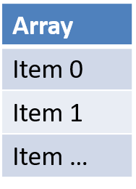
Basic of JavaScript
JS is case-sensitive (80% developers does case-sensitive errors)
Every statement in JS ends with semi-column
JS Naming convention is camel case, the first letter of any word is small, next consecutive word’s first letter is caps.
Ex:-
iloveindia ➔ iLoveIndia
wearelearningJS ➔ weAreLearningJs
An array is a collection of values, each value is an item of an array. The index of first item always starts with zero (0)
Syntax for Array
var aItems = [item0, item1,….]
Ex:
var myArr = [1, 2, 3, 4, 5];
var myArr2 = [‘a’, ‘b’, ‘c’];
Objects are like structures to contain multiple fields of different kinds.
Syntax for object
var oObjName = { “prop”: value,
“prop”: value,
“prop”: value }
Example of an Object
{
"empStructure": {
"empNo": 100001,
"empName": “Anubhav",
"salary": 5000,
"currency": “USD"
}
}

Slide 5
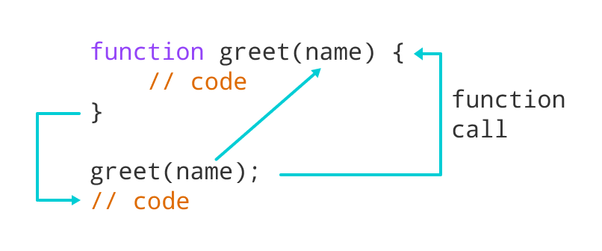
Functions in JavaScript
Functions in JavaScript
A JavaScript function is a block of code designed to perform a particular task.
A JavaScript function is executed when "something" invokes it (calls it).
A JavaScript function is defined with the function keyword, followed by a name, followed by parentheses ().
The code to be executed, by the function, is placed inside curly brackets: {}
Function parameters are listed inside the parentheses () in the function definition.
Function arguments are the values received by the function when it is invoked.
Inside the function, the arguments (the parameters) behave as local variables.
Types of functions
Functions are of 2 types →
1. Anonymous function
function(params) {
//code
}
2. Named Function
function functionName(params) {
//code
}

Slide 6

NPM – Node Package Manager
Node Package Manager (NPM) is a command line tool that installs, updates or uninstalls Node.js packages in your application. It is also an online repository for open-source Node.js packages. The node community around the world creates useful modules and publishes them as packages in this repository.
npm is the world's largest Software Registry.
The registry contains over 800,000 code packages.
Open-source developers use npm to share software.
Many organizations also use npm to manage private development.
npm is installed with Node.js
NPM is included with Node.js installation. After you install Node.js, verify NPM installation by writing the following command in terminal or command prompt ‘npm –v’
Npm command to add NodeJS modules in the Project. ‘npm install <package Name>’
https://www.npmjs.com/
JS is asynchronous Non Blocking Programming language. Also is an event driven programming language.
Server
Java
ABAP
Client
Java Script
Node JS
Java Script

Slide 7
Sequence Diagram
UI
Module
w
async
Util (in-built)
Callbacks
Promise

Slide 8
Title
Content

Slide 9
Title
Content

Slide 10
Title
Content

Slide 11

End of Day 2

Slide 12

Questions

Slide 13

Anubhav Oberoy

Slide 14


We’re committed to empower you to be
Most Desirable Resource
through powerful training solutions.
We build the workforce of the future.
250+
Corporate Clients
30,000+
Learners Trained
25000+
Learners Placed
FREE WEBINARS
Sign up for free webinars with industry experts every fortnight!
Enroll Now!
Contact us today!
https://anubhavtrainings.com/

Slide 15




More from AnubhavTrainings.com

Slide 16
Title
Content

